Slide 1
Empowering and enabling the logistics industry globally.
Behavioral Design Patterns
Nancy Li
Software Developer
11 Aug 2023

Slide 2
Design Patterns
Behavioral Design Patterns
Creational Design Patterns
Structural Design Patterns
Notes:
Design patterns are typical solutions to commonly occurring problems in software design.
When a solution gets repeated over and over in various projects, someone eventually puts a name to it and describes the solution in detail.
That’s basically how a pattern gets discovered.
You can follow the pattern details and implement a solution that suits the realities of your own program.
Design patterns are divided into three main categories
The first category is Creational patterns, for which I made a presentation last year.
The second is Structural patterns. That's what I want to talk about today.
Structural patterns explain how to assemble objects and classes into larger structures, while keeping these structures flexible and efficient.
//Creational patterns provide object creation mechanisms that increase flexibility and reuse of existing code.
//Behavioral patterns take care of effective communication and the assignment of responsibilities between objects.

Slide 3
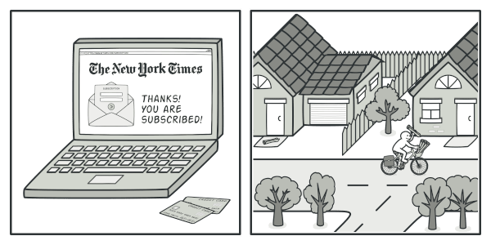
1. Observer
Notes:
观察者模式是一种行为模式，用于在对象之间建立一种一对多的依赖关系。
当一个对象的状态发生变化时，它会自动通知其依赖对象，使得依赖对象能够自动更新自己

Slide 4
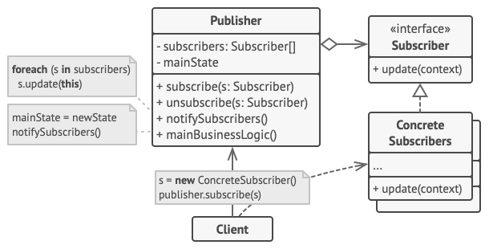
1. Observer
Publisher
Subscriber
Concrete Subscribers
Notes:
在这种模式中，存在两种类型的对象：主题（Subject）和观察者（Observer）
主题（Subject）是被观察的对象，它维护着一个观察者列表，并提供了用于添加、删除和通知观察者的方法。
当主题的状态发生变化时，它会遍历观察者列表，调用每个观察者的更新方法，以通知它们状态的改变。
观察者（Observer）是依赖于主题的对象，它们通过注册到主题上来接收状态的变化通知。
观察者必须实现一个更新方法，以便主题在状态改变时能够调用它们的更新方法。

Slide 5
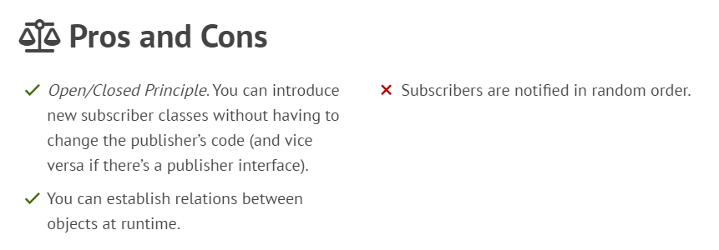
1. Observer

Slide 6
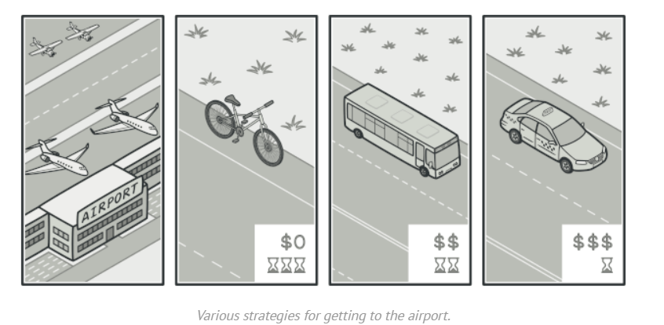
2. Strategy

Slide 7
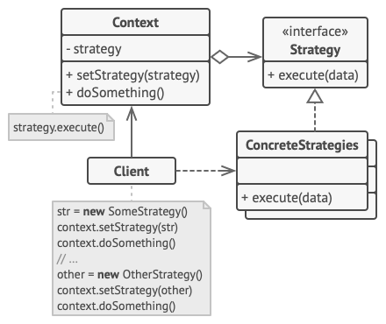
2. Strategy
Context
Strategy
Concrete Strategy

Slide 8
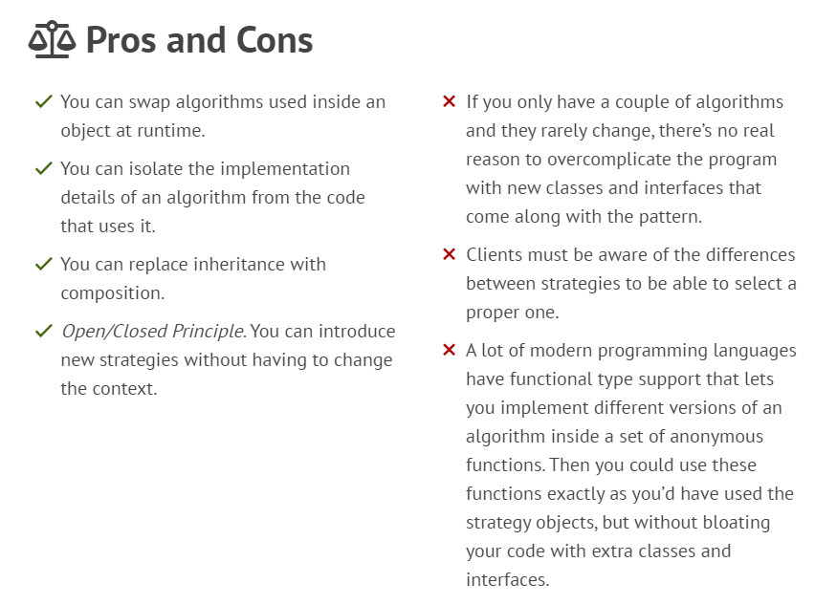
2. Strategy

Slide 9
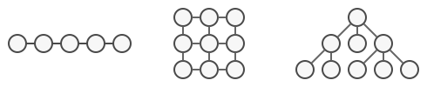
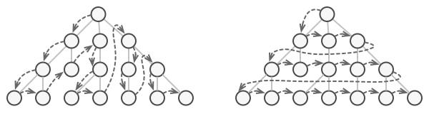
3. Iterator
The same collection can be traversed in several different ways.

Slide 10
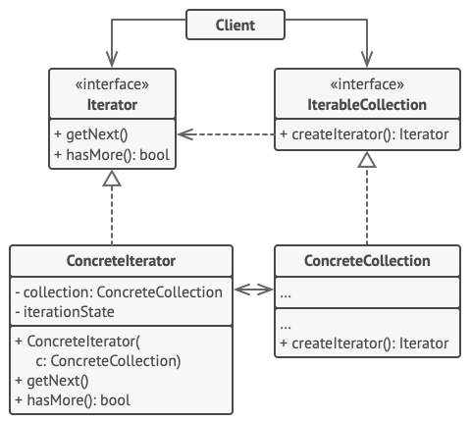
3. Iterator
Iterator
Concrete Iterators

Slide 11
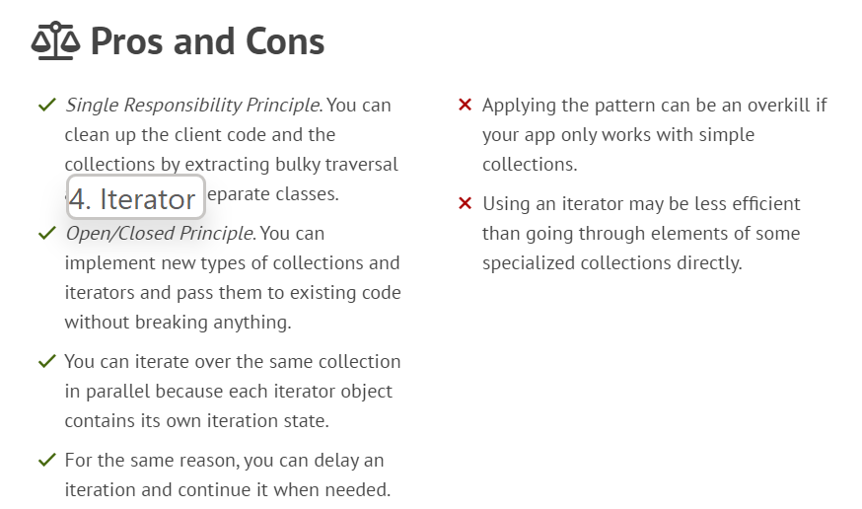
3. Iterator

Slide 12
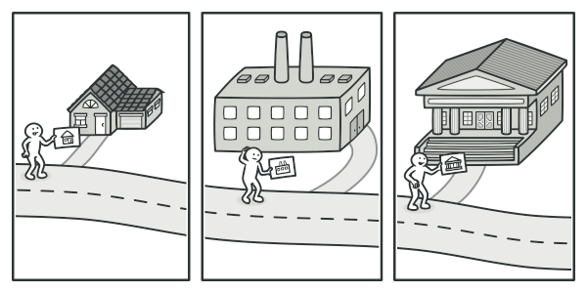
5. Visitor

Slide 13
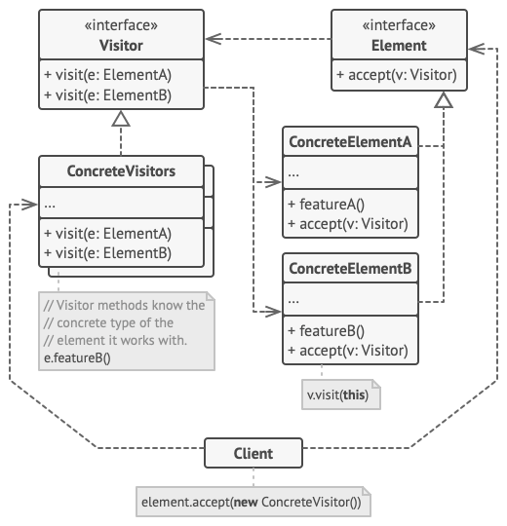
5. Visitor
Element
Concrete Visitors
Visitor
Concrete Elements

Slide 14
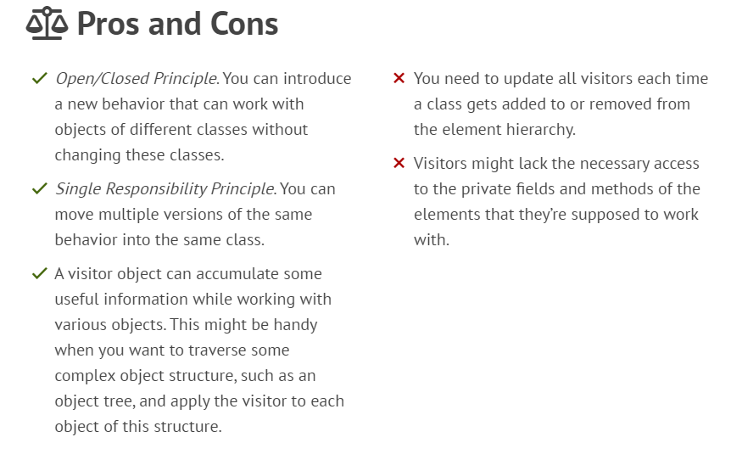
5. Visitor

Slide 15
Behavioral Design Patterns
1. Observer
2. Strategy
3. Iterator
…….
5. Visitor
4. Command
Notes:
These are the five Structural Design Patterns.
I hope it can be helpful to everyone.

Slide 16
Q&A

Slide 17
Empowering and enabling the logistics industry globally.
Thank You!

